Slide 1


DREAMERS
TEAM
GRADUATION PROJECT TEAM

Slide 2


OUTLINES
Team Members
Traditional Trade Problems
Electronic Commerce E-Commerce Solutions
Introduction About System
Technologies

Slide 3



TEAM MEMBERS
TEAM MEMBERS
Eslam El-far
Mazen El-Alfy
Sama Maged
Front End Developer
UI/UX Designer
FLutter Developer
CS Department
IT Department
IT Department
Team Leader

Slide 4



TEAM MEMBERS
TEAM MEMBERS
Mohamed Nasr
Shrouq El-Sweesy
Rowida Mohamed
Flutter Developer
Back End Developer
Back End Developer
IT Department
CS Department
CS Department

Slide 5


TEAM MEMBERS
TEAM MEMBERS
Omnya Azmy
Ahmed El-Sharabasy
Back End Developer
Business Analyst
IT Department
IS Department

Slide 6

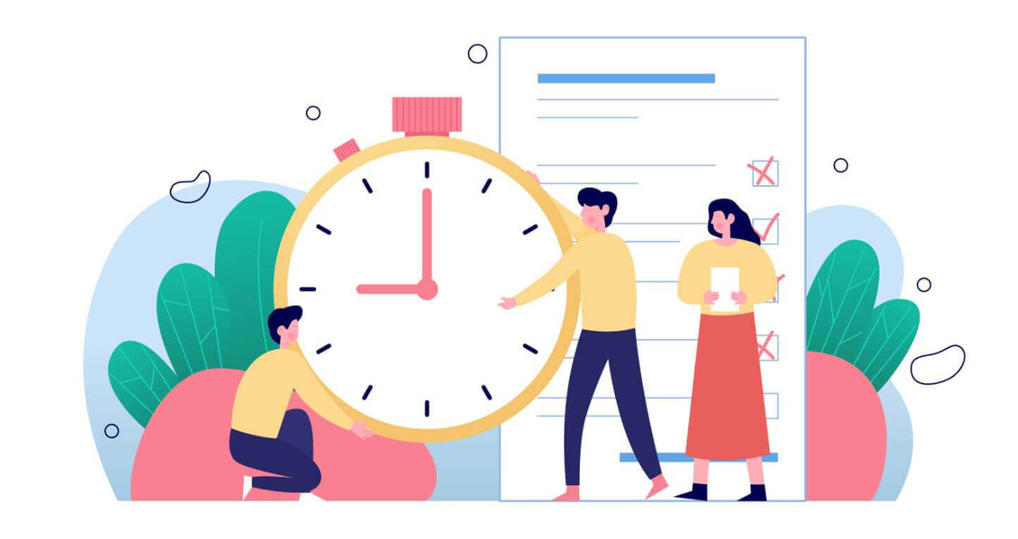
Traditional Trade Problems
1
The Importance Of The Time Factor

Slide 7
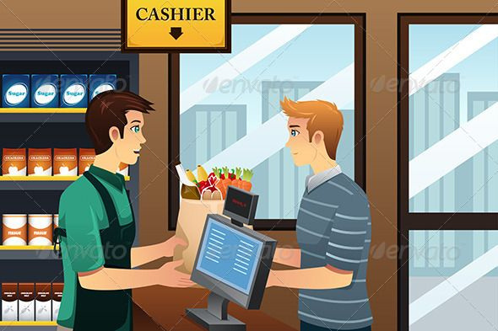
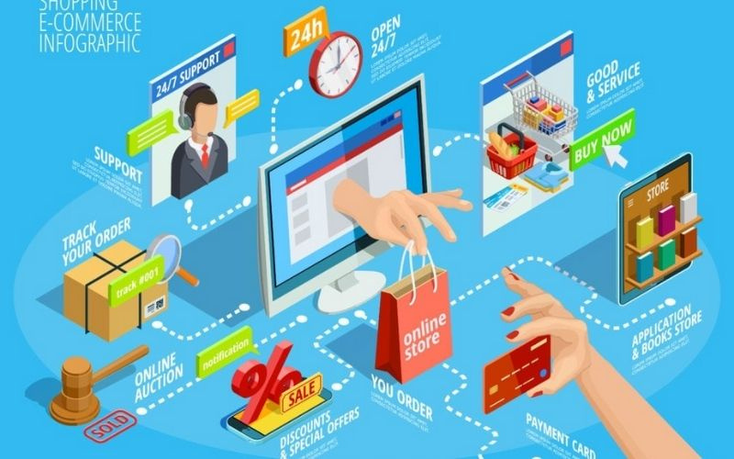
Traditional Trade Problems
1
The Importance Of The Time Factor
2
Geographical Factor

Slide 8
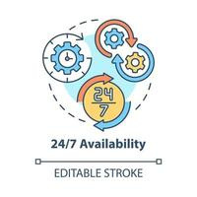
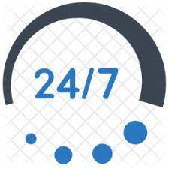
Traditional Trade Problems
1
The Importance Of The Time Factor
2
Geographical Factor
3
Not available all time​

Slide 9

Traditional Trade Problems
SERVICES
4
Lake of sufficient comfort while buying from traditional stores​

Slide 10
Traditional Trade Problems
4
Lake of sufficient comfort while buying from traditional stores​
5
Difficulty expressing opinions

Slide 11

Electronic Commerce
What is E-Commerce?
E-commerce (electronic commerce) is the buying and selling of goods and services, or the transmitting of funds or data, over an electronic network, primarily the internet

Slide 12
Electronic Commerce
What is E-Commerce?
E-commerce (electronic commerce) is the buying and selling of goods and services, or the transmitting of funds or data, over an electronic network, primarily the internet
How Does E-Commerce Work?
E-commerce is powered by the internet. Customers access an online store to browse through and place orders for products or services via their own devices.

Slide 13
Electronic Commerce
What is E-Commerce?
E-commerce (electronic commerce) is the buying and selling of goods and services, or the transmitting of funds or data, over an electronic network, primarily the internet
How Does E-Commerce Work?
E-commerce is powered by the internet. Customers access an online store to browse through and place orders for products or services via their own devices.
Types of e-commerce
Business-to-business (B2B)
Business-to-consumer (B2C)

Slide 14
Advantages of E-Commerce
(Traditional Trade Problem Solutions)
1
The Importance Of The Time Factor
The customer can order at any time he want from his place​

Slide 15
Advantages of E-Commerce
(Traditional Trade Problem Solutions)
1
The Importance Of The Time Factor
The customer can order at any time he want from his place​
2
Geographical Factor​
Easy to view all products without moving from my place and get rid of traveling and waiting in crowds

Slide 16
Advantages of E-Commerce
(Traditional Trade Problem Solutions)
1
The Importance Of The Time Factor
The customer can order at any time he want from his place​
2
Geographical Factor​
Easy to view all products without moving from my place and get rid of traveling and waiting in crowds
3
Not available all time
The purchase process is always available anytime and anywhere

Slide 17
Advantages of E-Commerce
(Traditional Trade Problem Solutions)
4
Lake of sufficient comfort while buying from traditional stores​
The presence of complete comfort for the customer during the purchase process where it’s not under pressure

Slide 18
Advantages of E-Commerce
(Traditional Trade Problem Solutions)
4
Lake of sufficient comfort while buying from traditional stores​
The presence of complete comfort for the customer during the purchase process where it’s not under pressure
5
Difficulty express opinion
The ability to know customer evaluation of products and use them to improve service in the future

Slide 19
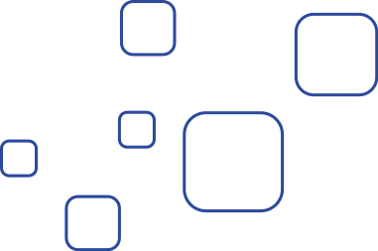


Introduction About system
Project Name
Home Bazzar

Slide 20
Introduction About system
Project Name
Home Bazzar
The Idea
The project revolves around creating a website and mobile application for home furniture by displaying the works of exhibition owners and home furnishing companies.

Slide 21
Introduction About system
Project Name
Home Bazzar
The Idea
The project revolves around creating a website and mobile application for home furniture by displaying the works of exhibition owners and home furnishing companies.
The general meaning is to create a moving gallery aimed at saving time and effort for the customer.

Slide 22
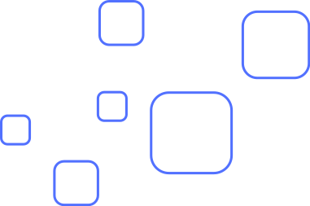
System Technologies
User Interface ( UI )
Front End
Flutter
Machine Learning
Back End

Slide 23


User Interface ( UI )
What is User Interface (UI) Design?
User interface (UI) design is the process designers use to build interfaces in software or computerized devices.
UI focusing on looks or style. Designers aim to create interfaces which users find easy to use and pleasurable.

Slide 24
User Interface ( UI )
Why is user interface important?
User interface is important to meet user expectations and support the effective functionality of your site.
A well-executed user interface facilitates effective interaction between the user and the program, app or machine through contrasting visuals, clean design and responsiveness.

Slide 25

User Interface ( UI )
UI Tools
Adobe XD
Adobe XD helps you craft prototypes that look and feel like the real thing, so you can communicate your design vision and maintain alignment across your team efficiently

Slide 26
User Interface ( UI )
UI Tools
Adobe XD
Adobe XD helps you craft prototypes that look and feel like the real thing, so you can communicate your design vision and maintain alignment across your team efficiently
Adobe Photoshop
Adobe Photoshop is software that is extensively used for raster image editing, graphic design and digital art. It makes use of layering to allow for depth and flexibility in the design and editing process

Slide 27
User Interface ( UI )
UI Tools
Adobe illustrator
Adobe Illustrator is a software application for creating drawings, create a variety of digital and printed images, including cartoons, charts, diagrams, graphs, logos, and illustrations

Slide 28
User Interface ( UI )
UI Tools
Adobe illustrator
Adobe Illustrator is a software application for creating drawings, create a variety of digital and printed images, including cartoons, charts, diagrams, graphs, logos, and illustrations
Adobe After Effect
Adobe After Effects is a 2.5D animation software used for animation, visual effects, and motion picture compositing. After Effects is used in film, TV, and web video creation.

Slide 29
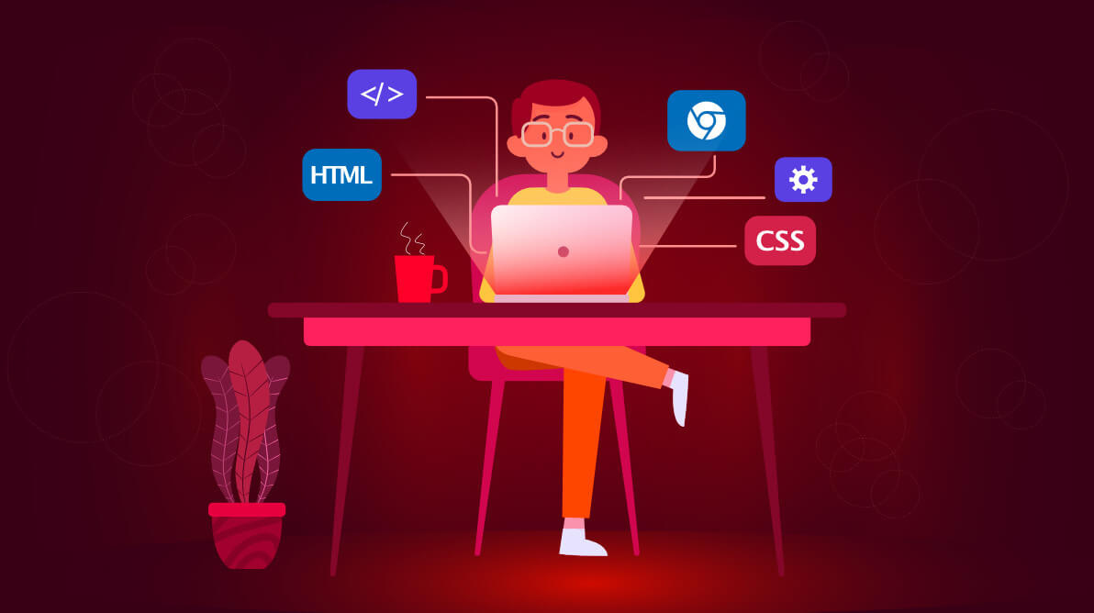
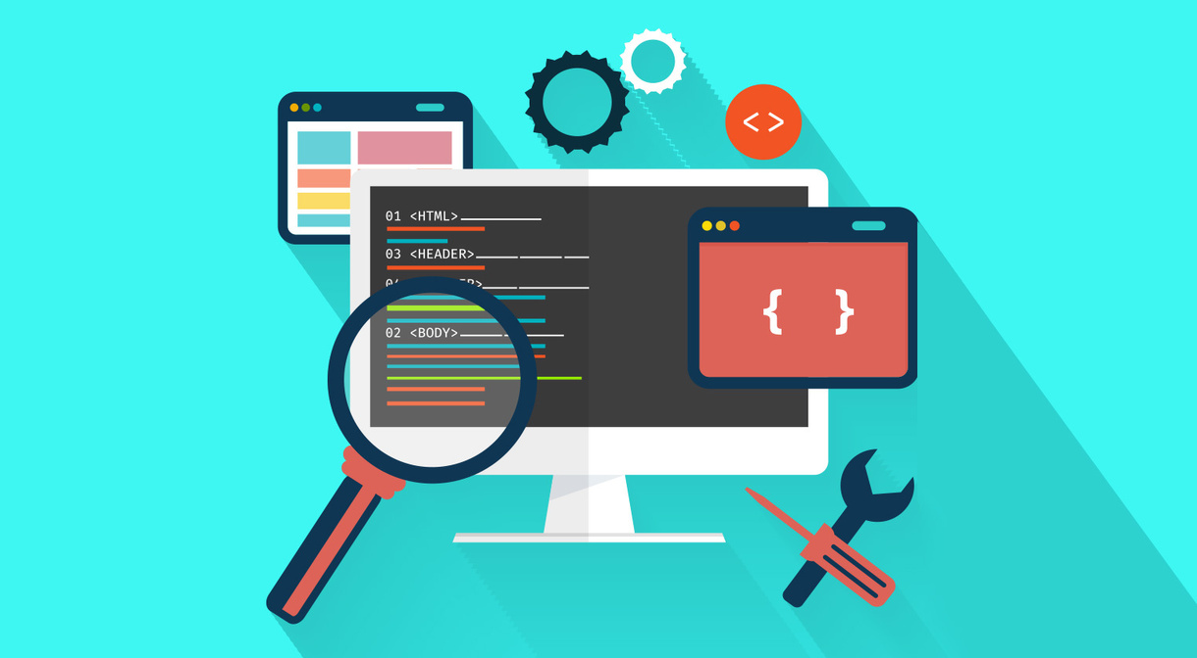
Front End
What is a Front-End?
The front-end of a website is the part that users interact with.
Everything that you see when you’re navigating around the Internet, from fonts and colors to dropdown menus and sliders.
is a combo of HTML, CSS, and JavaScript being controlled by your computer’s browser.

Slide 30
Front End
Front-End Tools
HTML
is a markup language for the web that defines the structure of web pages, it is one of the most basic building blocks of every website

Slide 31
Front End
Front-End Tools
HTML
is a markup language for the web that defines the structure of web pages, it is one of the most basic building blocks of every website
CSS
Cascading style sheets are used to format the layout of Web pages. They can be used to define text styles, table sizes, and other.

Slide 32
Front End
Front-End Tools
JS ( Java Script )
JavaScript is a dynamic programming language that's used for web development, in web applications. It allows you to implement dynamic features

Slide 33
Front End
Front-End Tools
JS ( Java Script )
JavaScript is a dynamic programming language that's used for web development, in web applications. It allows you to implement dynamic features
Bootstrap Framework
Bootstrap is a free, open source front-end development framework for the creation of websites.

Slide 34
Front End
Front-End Tools
React JS Library
React js, more commonly known as React, is a free, open-source JavaScript library. It works best to build user interfaces by combining sections of code (components) into full websites.
Swiper JS Library
What is Swiper? Swiper is a JavaScript library that creates modern touch sliders with hardware-accelerated transitions

Slide 35
Front End
Front-End Tools
React JS Library
React js, more commonly known as React, is a free, open-source JavaScript library. It works best to build user interfaces by combining sections of code (components) into full websites.
Swiper JS Library
Swiper is a JavaScript library that creates modern touch sliders with hardware-accelerated transitions

Slide 36

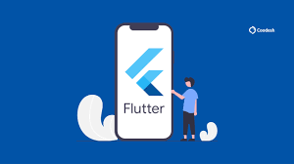
Flutter
What is a Flutter?
is a cross platform framework which has the capability to convert a single code base into an app that could run on Android, iOS, web, windows and Linux.

Slide 37
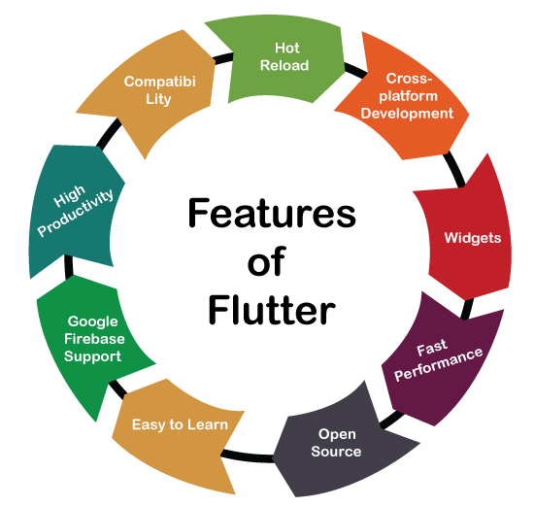
Flutter
Features of Flutter

Slide 38
Flutter
Flutter Tools
Material
is the design system of Google it provides the Custom widgets like Scaffold, Floating action button and many other widgets, and it also provides the Stateless of statefull widgets and their life-cycle.

Slide 39
Flutter
Flutter Tools
Material
is the design system of Google it provides the Custom widgets like Scaffold, Floating action button and many other widgets, and it also provides the Stateless of statefull widgets and their life-cycle.
Cupertino
like Material, However Cupertino is the design system of Apple, we use it we need some adaptivity to the app.

Slide 40
Flutter
Flutter Tools
dart:io
This library allows you to work with files, directories, sockets, processes, HTTP servers and clients, and more. Many operations related to input and output are asynchronous and are handled using Futures or Streams, both of which are defined in the dart:async library.

Slide 41
Flutter
Flutter Tools
dart:io
This library allows you to work with files, directories, sockets, processes, HTTP servers and clients, and more. Many operations related to input and output are asynchronous and are handled using Futures or Streams, both of which are defined in the dart:async library.
dart:services
This library depends only on core Dart libraries and the foundation library. we need it whenever we need to perform any task that need the device's core functionalities.

Slide 42
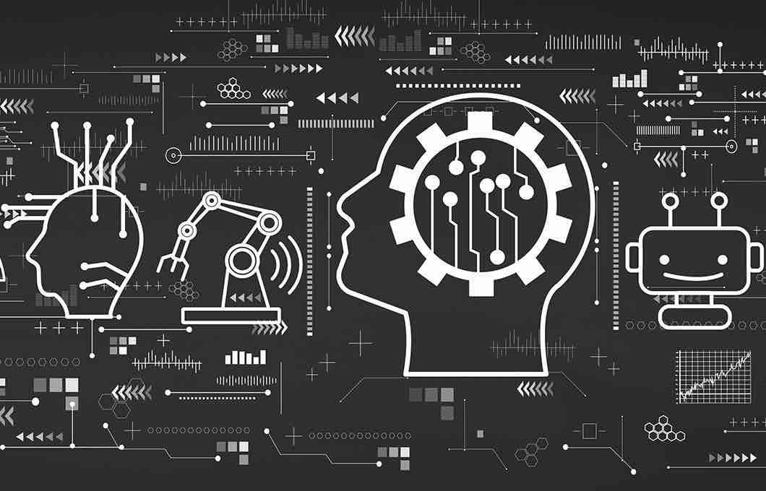
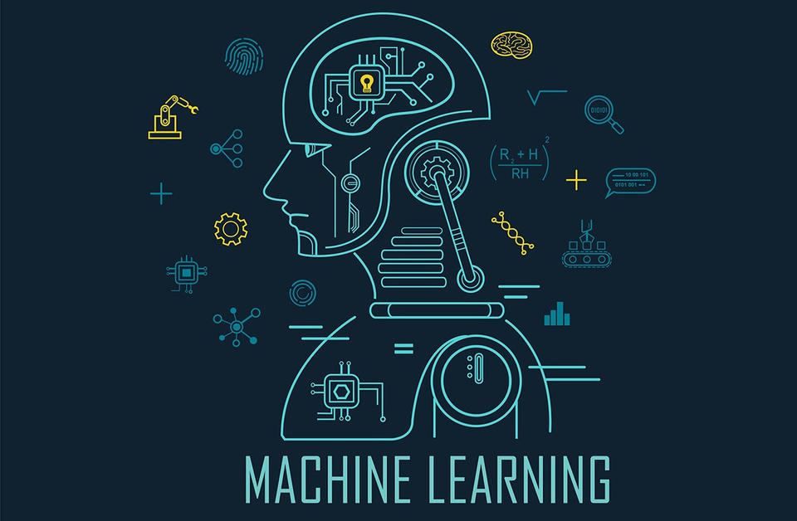
Machine Learning
What is a Machine Learning?
Machine learning is a branch of artificial intelligence (AI) and computer science
it's focuses on the use of data and algorithms to imitate the way that humans learn, gradually improving its accuracy.

Slide 43
Machine Learning
Machine Learning Idea in System
( Recommendation System )
machine learning model that can be used to predict customer behavior.
These models can be used to recommend products or services based on past purchases or browsing behavior, as well as predicting future purchases or behaviors

Slide 44
Machine Learning
Machine Learning Idea in System
( Recommendation System )
machine learning model that can be used to predict customer behavior.
These models can be used to recommend products or services based on past purchases or browsing behavior, as well as predicting future purchases or behaviors
ex.
market basket analysis using the Apriori algorithm.

Slide 45
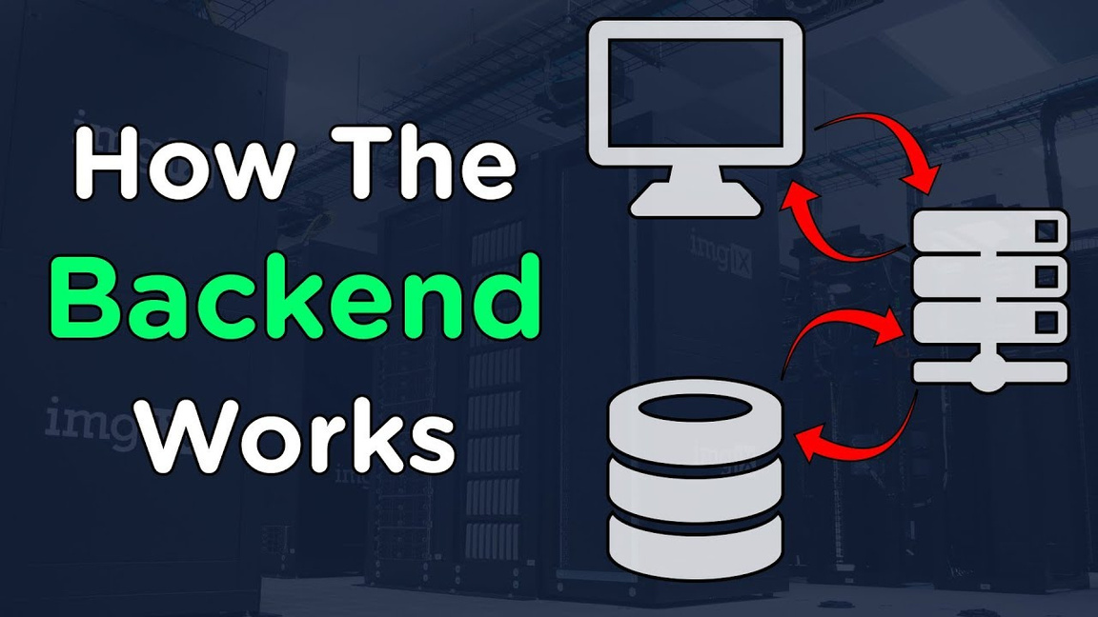
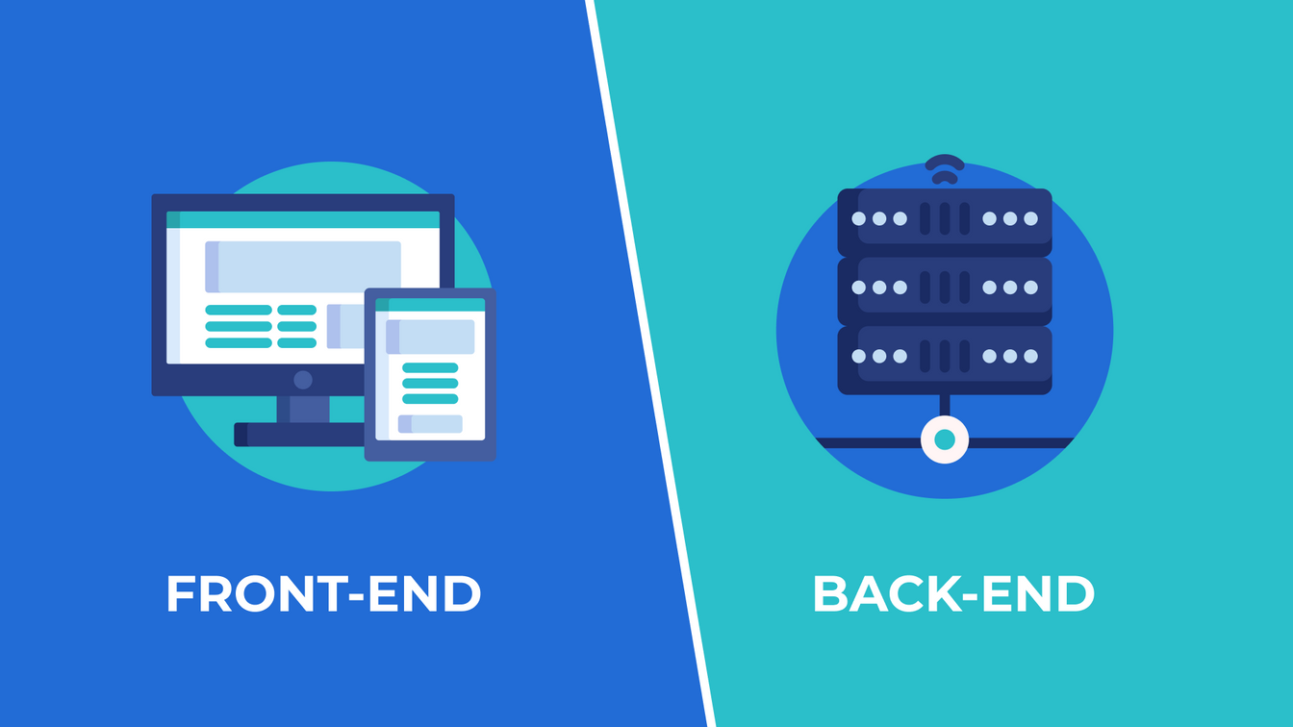
Front End
What is a Back-End?
An invisible part of the site.

Slide 46
Front End
What is a Back-End Developer?
An invisible part of the site.
Responsible for storing and organizing data.

Slide 47
Front End
What is a Back-End Developer?
An invisible part of the site.
Responsible for storing and organizing data.
Responsible for the protection part of the site.

Slide 48
Front End
What is a Back-End Developer?
An invisible part of the site.
Responsible for storing and organizing data.
Responsible for the protection part of the site.
The Back-end communicates with the interface of the site, so it sends and receives information and then displays it on the site.

Slide 49
Front End
What is a Back-End Developer?
Your site needs a database that stores content in a structure that makes it easy to retrieve, organize, modify, and save, running on a server.

Slide 50
Front End
What is a Back-End Developer?
Your site needs a database that stores content in a structure that makes it easy to retrieve, organize, modify, and save, running on a server.
Whenever you view a product or make a purchase, it sends a request to the server and then returns the required information from the database.

Slide 51
Front End
Back-End Tools
Database System ( MySQL )
The MySQL language is very fast in querying the database and is characterized by the ease of linking tables to the user interface.

Slide 52
Front End
Back-End Tools
Database System ( MySQL )
The MySQL language is very fast in querying the database and is characterized by the ease of linking tables to the user interface.
PHP language
An extremely popular scripting language that is used to create dynamic Web pages.
Safe, simple, easy to handle and works very quickly.

Slide 53
Front End
Back-End Tools
Laravel
It is a framework work built in the PHP language, based on the MVC method, which separates the model from the view from the controller, and this facilitates the work environment.
Laravel web applications are highly scalable and have well-structured codebases.

